Slide 1

2025 2nd International Conference on Data Science and Business Systems
Paper ID: 2490
Title: AI-Driven Smart Safety framework for Community Protection
Track - 2
Presenter Name: A.Pious Niranjan, K.Thanush, R.Santhosh, N.Dhanush Raj
Designation & Affiliation: Dr. M.G.R. Educational and Research Institute

Slide 2


Slide 3
Outline
Introduction
Existing Approaches/Related Works
Problems in Existing Approaches
Proposed Methodology
Results and Discussion
Conclusions and Future Work
References

Slide 4
Introduction
Community safety remains a critical challenge in the evolution of smart cities, especially in the face of increasing incidents of theft, fire hazards, gas leaks, and delayed emergency responses. A focused study conducted in residential areas of Chennai revealed that 65.2% of residents reported theft experiences—primarily in shared community spaces—and 55.6% encountered gas leaks, with 72.8% expressing high concern over safety threats.
To address these pressing issues, we developed an AI-Integrated Home and Community Safety System, leveraging IoT sensors, real-time MQTT communication, and mobile-based dashboards for instant monitoring and alerting. The system includes flame and gas detection, medical and theft emergency buttons, and LED and buzzer-based notification mechanisms.
Backed by a survey of 408 residents, our findings show strong support for AI-driven safety innovations, with 67.4% rating the proposed solution as highly effective and 79.7% willing to adopt it. The system aligns with Sustainable Development Goals—notably SDG 11 (Sustainable Cities) and SDG 9 (Industry, Innovation, and Infrastructure)—by enhancing urban resilience and promoting smart safety infrastructure.

Slide 5
Existing Approaches/Related Works
A. Limitations of Current Security Systems
Traditional systems (CCTV, alarms, smart locks) are widely used.
Common issues:
High cost
Delayed response times
Lack of AI-based real-time intervention
B. Smart Home Security Solutions
Sherif et al. [1]: LoRa-based alerts, but lacks full automation.
Alahi et al. [2]: Focused on surveillance, not active response.
Yu & Zhang [3]: Contactless detection; AI use still in early stage.
Nettikadan [5], Çavaş [6]: MQTT and IoT used, but no predictive AI.
Other works included motion sensors, facial recognition, GSM alerts—but lacked AI-coordinated response.

Slide 6
Existing Approaches/Related Works
C. Communication & Alert Mechanisms
Merjanian et al. [9]: Group-based safety notifications, but manual.
Fujii et al. [10]: e-JIKEI neighborhood network—no AI prediction.
Mobile-based apps with GPS, panic buttons, drone support (e.g., Kerning [13])—focused on individuals, not communities.
D. AI & IoT-Based Enhancements
Ni et al. [14], Freund [15]: AI integration begins, but still fragmented.
Long [16], Varadarajan [17]: AI for facial recognition, home automation—not for comprehensive safety.
Dawson [18]: Real-time clusters, yet no forecasting via AI.
Identified Gaps
Most solutions:
Are reactive, not predictive.
Focus on individual safety, not community coordination.
Depend on manual input, delaying response time.

Slide 7
Problems in Existing Approaches
🔒 Lack of Unified Emergency Handling
Existing systems handle fire, gas leaks, or theft independently.
No integrated platform for multi-hazard detection and coordinated alerting.
📞 Delayed Response and Notification
Systems often rely on manual communication (calls, neighbors).
GSM-based alerts have higher latency and limited reliability.
📉 High False Alarm Rates
Many systems trigger alarms without intelligent filtering.
False positives cause panic or reduce trust in alerts.
🚫 No AI Decision-Making
Most traditional devices lack AI-driven filtering or pattern recognition.
No differentiation between false alarms and real threats.
📡 Limited Communication Scope
Alerts are sent only to owners or single homes, not to the community network.
No multi-house alert mechanism or real-time broadcasting.
🔋 Power Dependency
Many safety systems fail during power outages.
Lack of solar-powered or backup energy options.
🌐 Weak Integration with Smart City Goals
No alignment with SDG 11 (Sustainable Cities) and SDG 9 (Innovation Infrastructure).
Low community-level automation and no data-driven governance support.

Slide 8
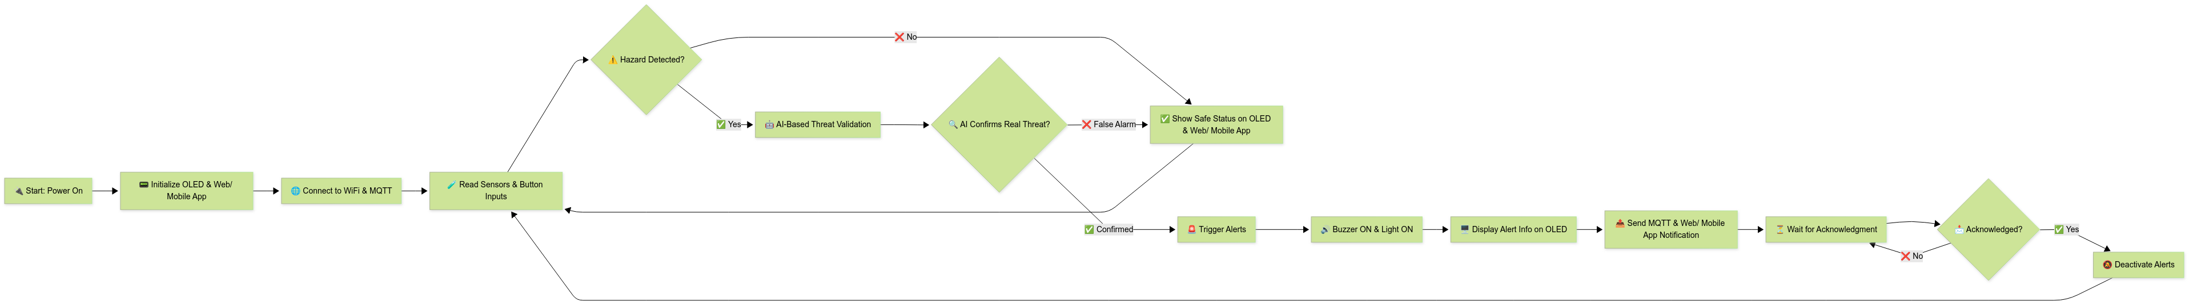
Proposed Methodology

Slide 9
Proposed Methodology
Proposed Methodology
1. System Architecture
Integrated Safety Solution: Combines hardware + software for real-time home & community security.
Core Tech: ESP8266 microcontroller + MQTT protocol + AI decision logic.
2. Hardware Components
Sensors: Gas (MQ2), Flame, Motion
Manual Alerts: Theft & Medical buttons (local + remote via app)
Alert System: Buzzer, OLED display
Power: Solar-powered backup for resilience
The proposed system offers several advantages over existing safety setups by integrating multi-trigger inputs (sensors and manual buttons), enabling AI-enhanced accuracy to minimize false alarms, utilizing faster MQTT-based communication instead of slower GSM, providing real-time control via dashboards and alerts, and supporting scalable deployment from individual homes to larger gated communities.
3. Software & AI Logic
Communication: MQTT (over TLS) for secure, real-time messaging
Interface: Web & Mobile app dashboards
AI Module: Lightweight decision tree for:
Real-vs-false threat filtering
Anomaly detection (sensor tampering/unusual patterns)
4. Communication Flow
Sensor data → ESP8266 → MQTT Broker →
Nearby Homes
Authorities
Web/App Interfaces
Community-wide alerts for theft, fire, gas leaks & medical emergencies

Slide 10
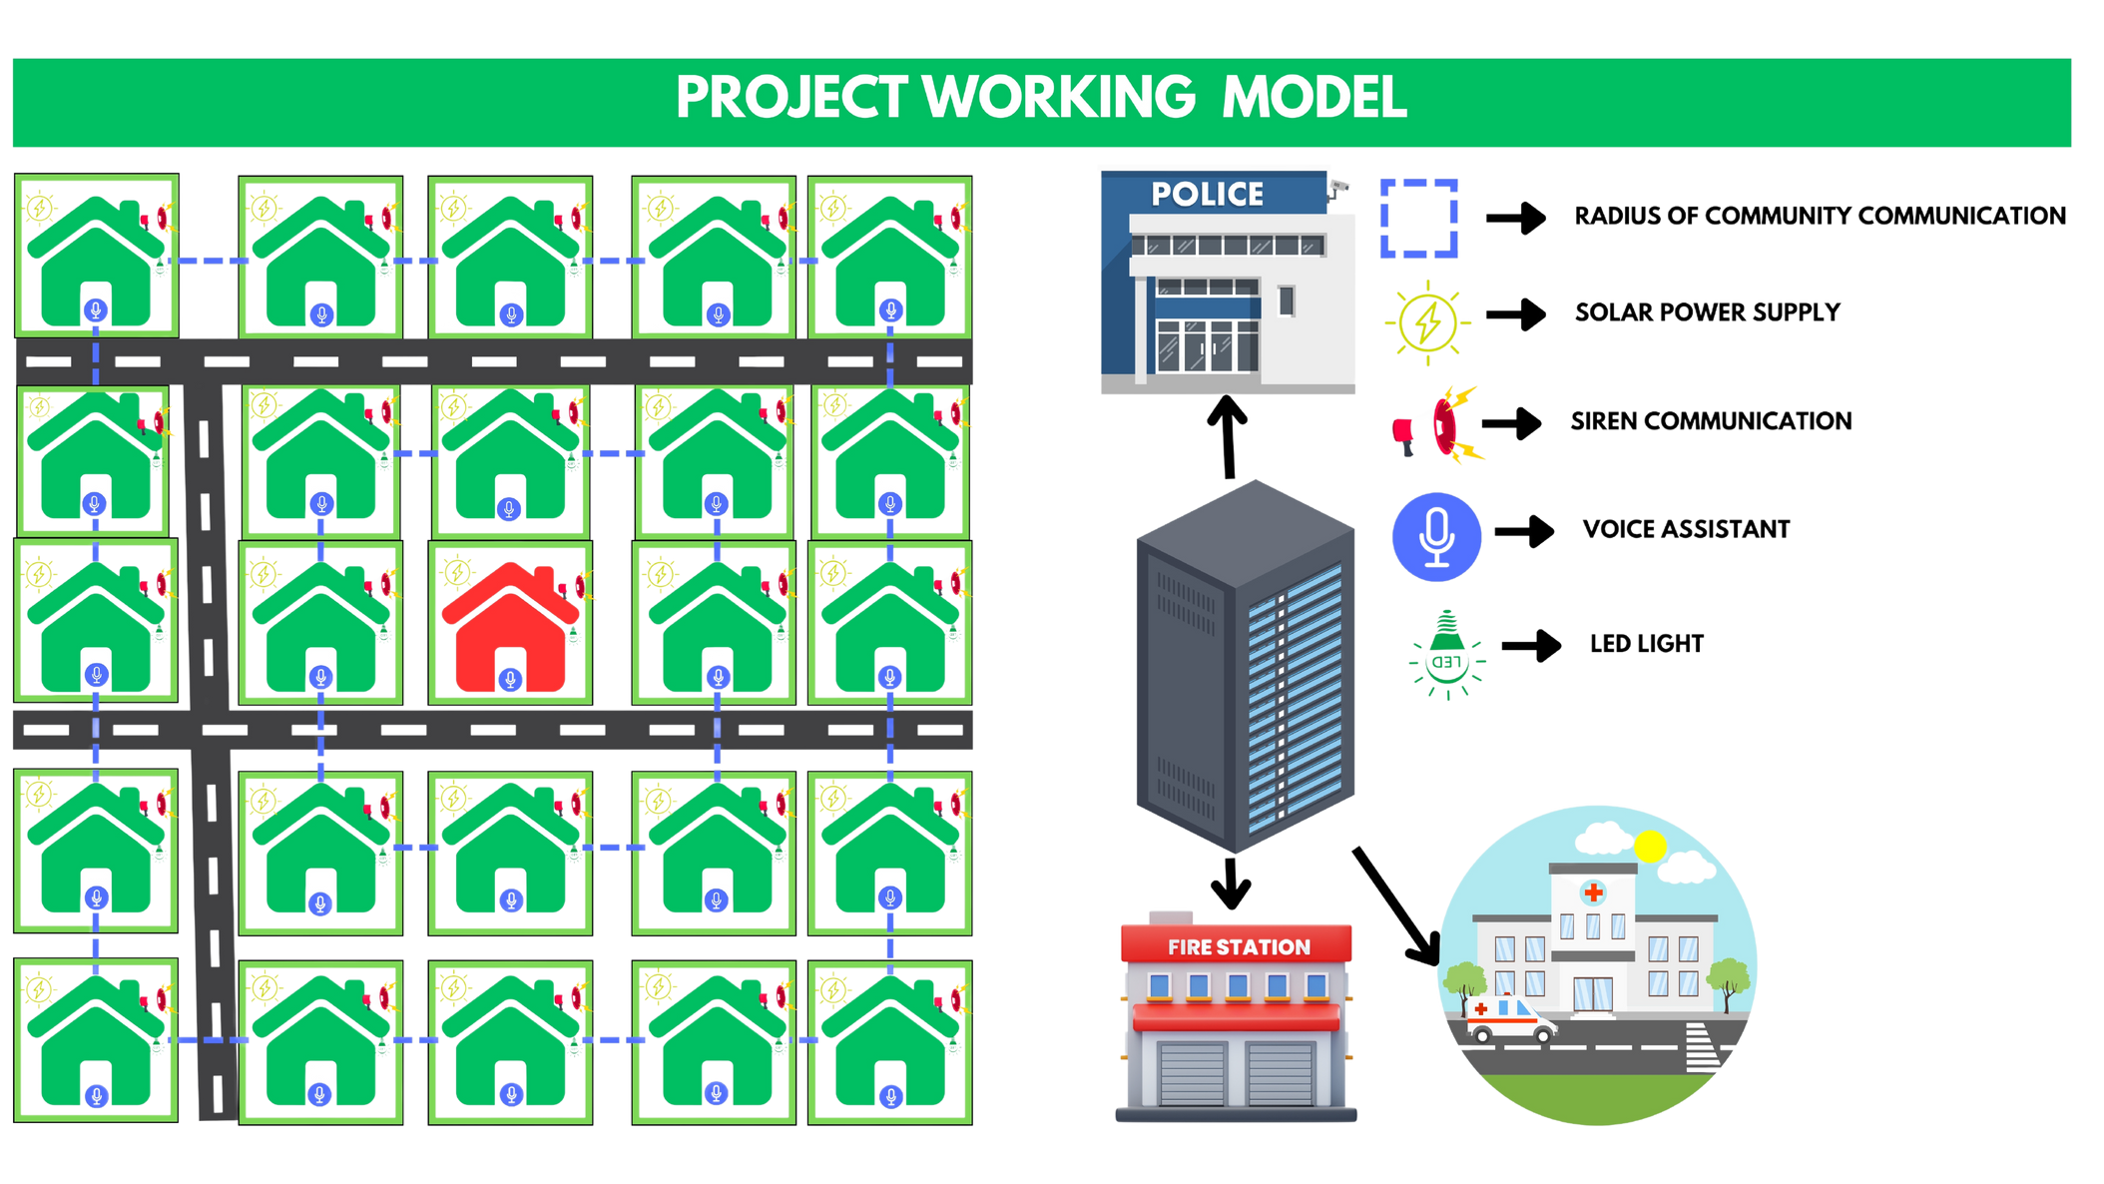
Proposed Methodology

Slide 11
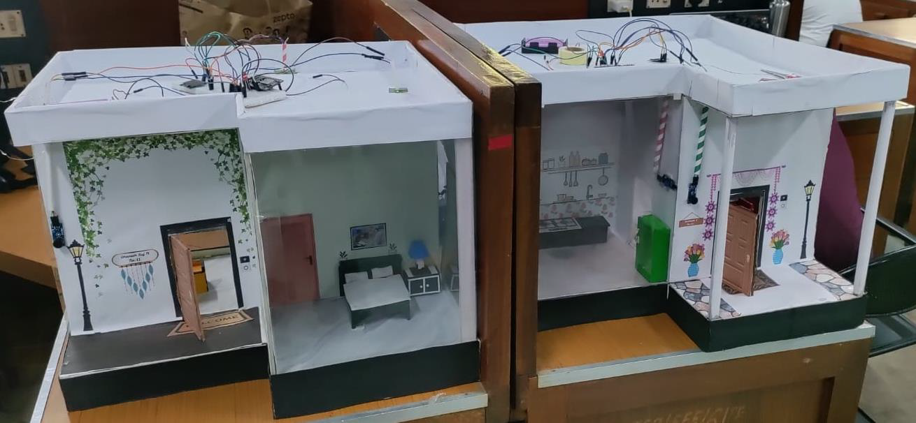
Results and Discussion
Case Study:
This case study shows MQTT communications system operation between two houses in a community setting, including fire, gas, theft, and medical alarms.

Slide 12
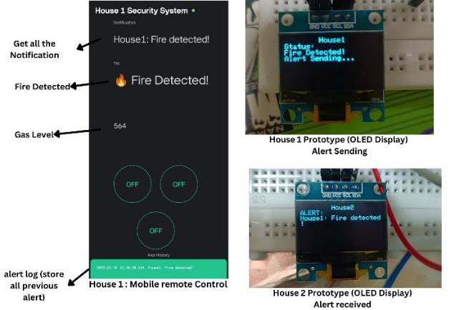
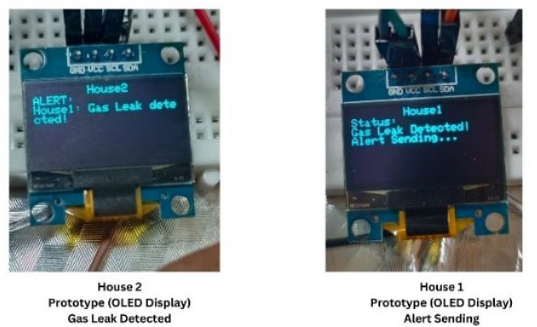
Case Study 1: Fire Detection and MQTT-Based Alert Propagation
Case Study 2: Gas Leak Detection and MQTT-Based Alert Propagation

Slide 13
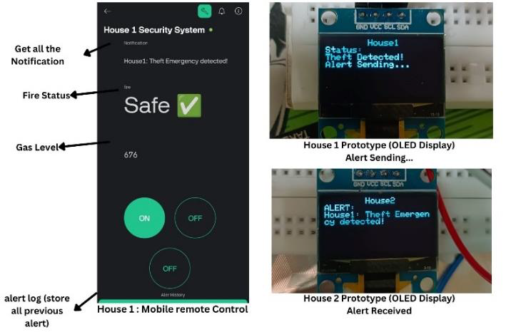
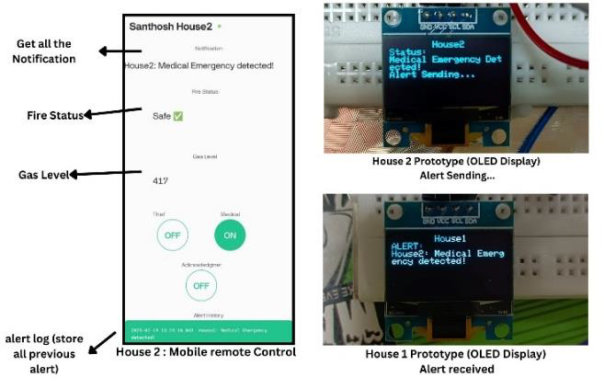
Case Study 3: Theft Detection and Emergency Response
Case Study 4: Medical Emergency Detection and Response

Slide 14
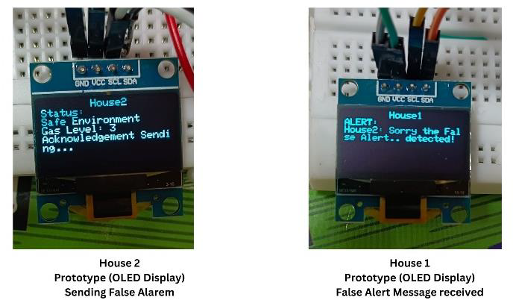
Case Study 5: False Alarm Detection and Acknowledgment Mechanism

Slide 15
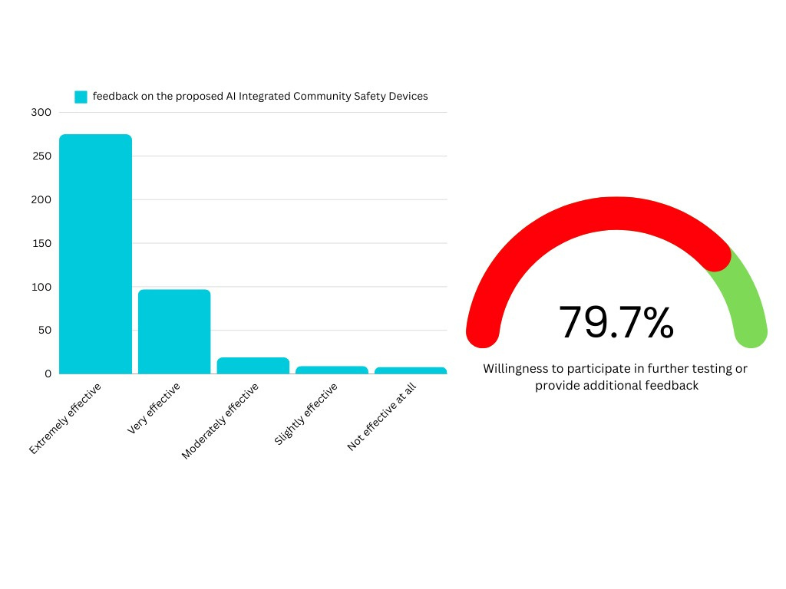


Results and Discussion of Survey of 408 Residents houses
Patent Published

Slide 16

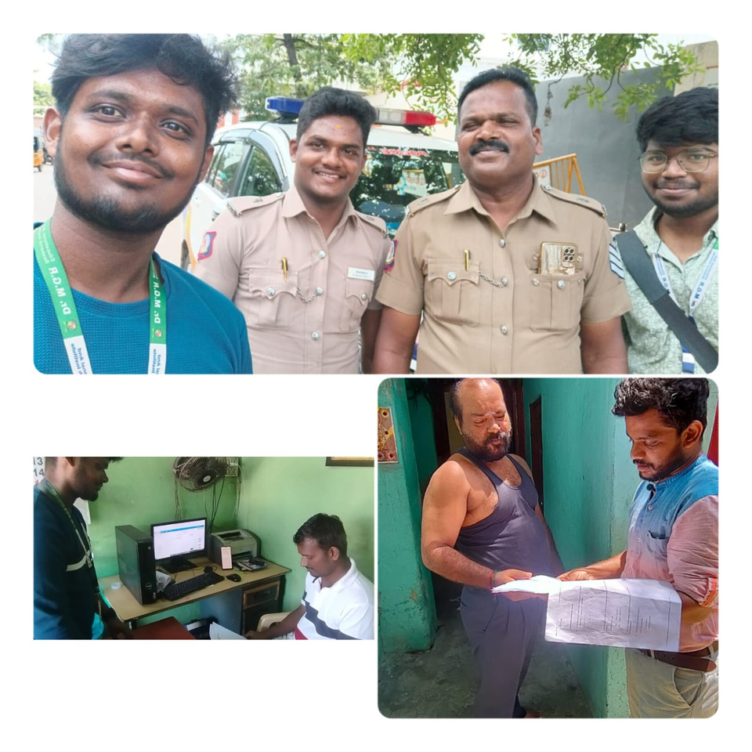
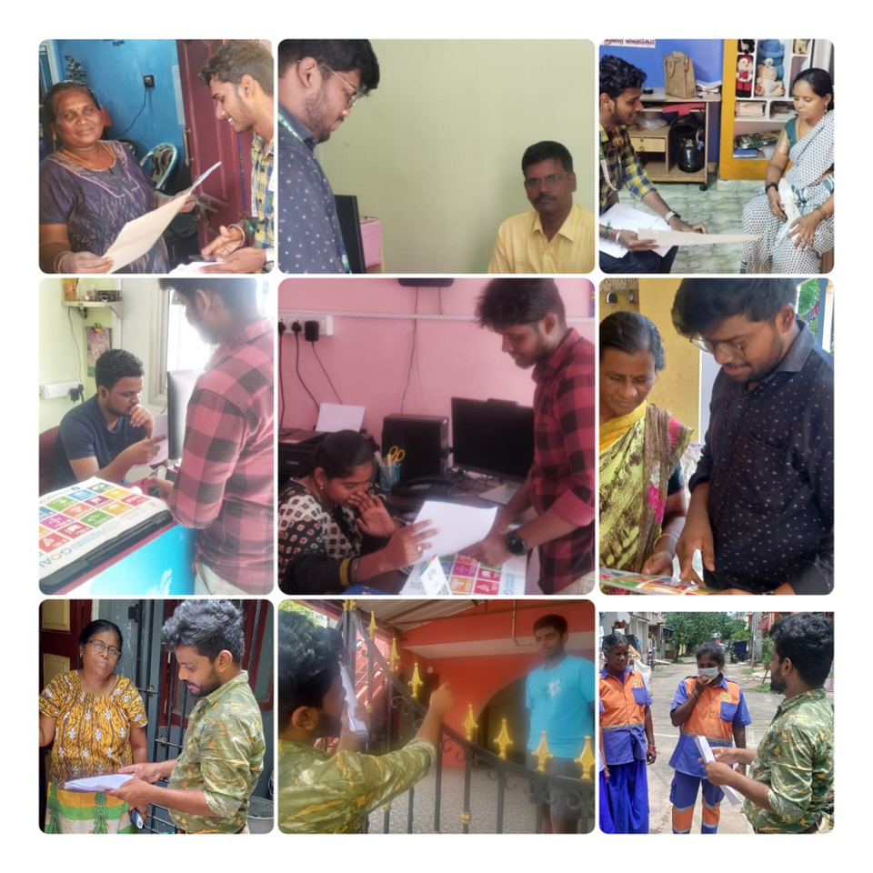
Survey Sample Photos

Slide 17
Conclusions and Future Work
Conclusion:
The proposed AI-Based Home & Community Safety System effectively addresses real-time emergencies (gas leaks, fire, theft, and health issues).
Integrates MQTT-based IoT alerts, local display, mobile & web interface for timely community response.
Promotes user-friendly emergency detection and neighborhood-wide awareness, enhancing urban resilience.
🌐 Scalability for Smart Cities:
Supports multi-home and community-wide integration.
Enables city-scale deployment through improved network coordination and alert sharing.
Future-ready for integration with municipal emergency services.
🔮 Future Enhancements:
AI-based threat filtering to reduce false alarms (e.g., pets, smoke).
Smart city integration with law enforcement, fire & medical services for auto-response.
Data security upgrades with MQTT-TLS, encrypted logs, and access control.
Expand system to multi-unit buildings, aligned with SDG 11 (Sustainable Cities) & SDG 9 (Innovation & Infrastructure).
📊 Key Survey Insights:
Theft: 65.2% experienced; 83.5% in community spaces.
Gas Leaks: 55.6% had experiences; cylinder leaks most common (38%).
AI Devices: 67.4% rated highly effective; 79.7% want to test/engage.
SDG Awareness: Only 14.7% aware → need stronger community outreach.

Slide 18
References
[1] A. Sherif, S. Sherif, C. P. Ooi, and W. H. Tan, "A LoRadriven home security system for a residential community in a retirement township," International Journal of Technology, vol. 10, no. 7, pp. 1297-1306, 2019.
[2] M. E. E. Alahi, A. Sukkuea, F. W. Tina, A. Nag, W. Kurdthongmee, K. Suwannarat, and S. C. Mukhopadhyay, "Integration of IoT-enabled technologies and artificial intelligence (AI) for smart city scenario: Recent advancements and future trends," Sensors, vol. 23, no. 11, p. 5206, May 2023 https://doi.org/10.3390/s23115206.
[3] X. Li, R. Lu, X. Liang, X. (S.) Shen, J. Chen, and X. Lin, "Smart community: An Internet of Things application," IEEE Communications Magazine, vol. 49, no. 11, pp. 12-13, Nov. 2011. doi: 10.1109/MCOM.2011.6069779.
[4] J. Han, W.-K. Park, I. Lee, H.-G. Roh, and S.-H. Kim, "Home-to-home communications for smart community with Internet of Things," in 2017 14th IEEE Annual Consumer Communications & Networking Conference (CCNC), Las Vegas, NV, USA, 2017, pp. 1-6.
[5] D. Nettikadan and S. R. M. S., "IoT based smart community monitoring platform for custom designed smart homes," in Proceedings of the 2018 IEEE International Conference on Current Trends toward Converging Technologies, Coimbatore, India, 2018, pp. 1-5. doi: 10.1109/CTCT.2018.978-1-5386-3702-9.

